Slide 1


Theory of Computation: A Problem-Solving Approach
Chapter – 9: Nature of Context-Free Languages

Slide 2
Learning Objectives
Learn how to combine context-free languages to obtain more complex languages.
Learn why context-free languages are not closed under intersection or complementation.
Learn to answer questions such as emptiness and finiteness of context-free languages.
Learn that equivalence or ambiguity questions of context-free languages cannot be answered!
Learn why some languages are not context-free.
Learn to apply the Pumping Lemma to show that a language is not context-free.

Slide 3
Context-Free Languages: Closure Properties
Context-free languages (CFLs):
Languages of non-deterministic pushdown automata
Languages of context-free grammars
Closure Properties of CFLs:
Union of two CFLs is a CFL
By combining two CFGs: S → S₁ | S₂
Concatenation of two CFLs is a CFL
By combining two CFGs: S → S₁S₂
* Closure of a CFL is a CFL
By adding S → SS₁ | S₁ | λ

Slide 4
CFLs are NOT Closed Under…
Complementation: The complement of a context-free language may not be a context-free language.
Intersection: The intersection of two context-free languages may not be a context-free language.
Set difference: The set difference of two context-free languages may not be a context-free language.
However, the intersection of a context-free and a regular language is context-free.

Slide 5
Example: Complement of a CFL
Subset of a*b*c* where either the number of a s is not equal to the number of b s or the number of b s is not equal to the number of c s (i.e., n_{a} ≠ n_{b} or n_{b} ≠ n_{c}).
This is a CFL since we can write a CFG for it:
S → S₁ | S₂
S₁ → S₃ | S₄ | S₁c | c
S₃ → aS₃ | aS₃b | a
S₄ → S₄b | aS₄b | b
S₂ → S₅ | S₆ | aS₂ | a
S₅ → bS₅ | bS₅c | b
S₆ → S₆c | bS₆c | c
The complement of this language, however, is the language a^{n}b^{n}c^{n} which is not a CFL.

Slide 6
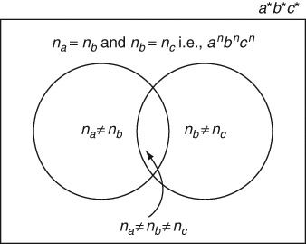
Example: Complement of a CFL
Complement of a CFL may not be a CFL

Slide 7
Decidable Questions about CFLs
Is a given context-free language empty? That is, given a representation of the language in the form of a context-free grammar, is there any string that is generated by it or is the language a null set?
If S is useless, i.e., non-generating, then the language is empty
Example of a CFL whose language is empty:
S → aA | bB | C
A → aA | Ab | bB
B → bB | Ba | aA
C → bA | aB | aSb | bSa
Is a given context-free language finite or Infinite? Infinite if products are cyclic.
Does a given string w belong to a context-free language L? This is called the membership question. We can apply the CYK algorithm to answer this.

Slide 8
Surprise: Undecidable Questions about CFLs
There is no method (or algorithm) to answer the following:
Are two context-free languages the same?
No way to compare to CFGs
Is a given context-free language ambiguous?
See Chapter 12 for other undecidable problems

Slide 9
Non-Context-Free Languages
Languages such as a^{n}b^{n}c^{n} and ww are not context-free.
Why?
They involve types of counting or matching that is not possible with the single stack of a pushdown automaton
They involve coordinating the derivation of two or more parts of the sentential form which is not possible in a context-free grammar
Pumping lemma for CFLs helps us show that such languages are not context-free.

Slide 10
Pumping Lemma for CFLs
In plain English: Context-free languages are context-free because every non-trivial string in every infinite context-free language (that is not regular) has two correlated repeating patterns at least one of which is not empty and the two patterns are not too far from each other; these two patterns can be repeated in equal numbers any number of times to generate infinitely many strings in the language.
Formally: Every infinite context-free language L has a constant m, specific to that language, such that all strings w, |w| ≥ m belonging to L can be split into w = uvxyz, where |vxy| ≤ m and |vy| ≥ 1 and for all i = 0, 1, 2, ..., the strings uv^{i}xy^{i}z belong to L.

Slide 11
Why is the Pumping Lemma True?
Consider a leftmost derivation of a long string using a Greibach Normal Form grammar for the language. In such a derivation:
there is no limit on the length of the input string;
there is no limit on the depth of the derivation tree;
there is no limit on the length of the path from a leaf node to S in the derivation tree;
but there is a finite number of variables in the grammar, and thus,
there must be at least one repeated variable along the path.
The productions used at the different occurrences of the repeated variable can be interchanged according to the grammar to either collapse or pull out and expand the derivation tree. This is what is called pumping on i in the Pumping Lemma for CFLs.

Slide 12
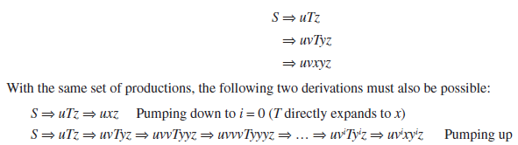
Why Pumping Lemma (contd..)
The resulting five parts of the yield of the tree are u, v, x, y and z.
u is the part derived by everything before the repeating variable T;
v is the part generated by T before repeating itself;
x is the part generated by T finally when it stops reappearing;
y is the part that is generated by T after repeating itself;
z is the part generated by everything after T.
With the same set of productions, the following two derivations must also be possible:

Slide 13
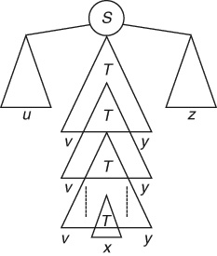
Why Pumping Lemma (contd..)

Slide 14
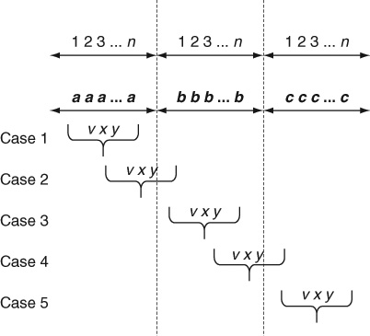
Using Pumping Lemma: Example 9.1
We cannot construct a CFG or PDA for a language such as a^{n}b^{n}c^{n}
Now let us prove that this language is not context-free. In a proof by contradiction using the Pumping Lemma, choose w = a^{m}b^{m}c^{m}
Possible Cases:

Slide 15
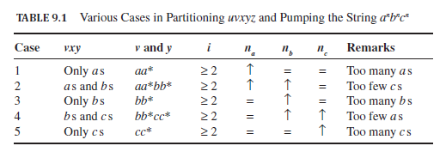
Pumping Lemma: Example 9.1 (contd..)

Slide 16
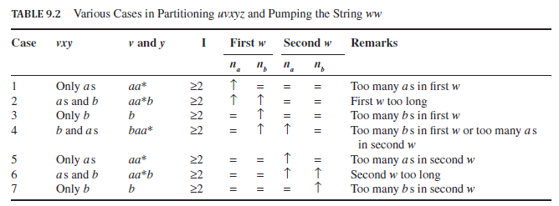
Pumping Lemma: Example 9.2
To show that ww is not context-free:

Slide 17
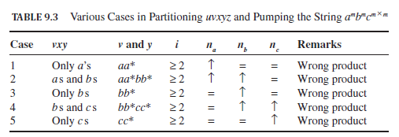
Pumping Lemma: Example 9.3
The formal language of multiplication is not a context-free language.
a^{p}b^{q}c^{r} where r = p x q
Choose w = a^{m}b^{m}c^{m x m}

Slide 18
Theorems
Theorem 16: Closure properties of CFL: Context-free languages are closed under union, concatenation and *-closure.
Corollary 16.1: CFLs are not closed under complementation, intersection or set-difference.
Theorem 17: Pumping Lemma for CFL: Every infinite context-free language L has a constant m, specific to that language, such that all strings w, |w| ≥ m belonging to L can be split into w = uvxyz, where |vxy| ≤ m and |vy| ≥ 1 and for all i = 0, 1, 2, ..., the strings uv^{i}xy^{i}z belong to L.
Theorem 18: Ogden’s Lemma: Every infinite context-free language L has a constant m, specific to that language, such that all strings w, |w| ≥ m belonging to L can be marked (or distinguished) at any m or more symbols and split into w = uvxyz, where vxy has at most m marked symbols, vy contains at least one marked symbol and for all i = 0, 1, 2, ..., the strings uv^{i}xy^{i}z belong to L.
Theorem 19: Decidable Questions about CFL: Algorithms exist to determine if a given context-free language is empty, finite or infinite; an algorithm exists to determine if a given string belongs to the language of a given context-free grammar.

Slide 19
Key Ideas
Combining context-free languages is not as simple as combining regular languages. Context-free languages are well-behaved only under the operations of union, concatenation and *-closure.
The complement of a context-free language or the intersection or set difference of two context-free languages may or may not be context-free.
A context-free language is empty if in any equivalent grammar, the start symbol S is non-generating.
A context-free language is finite if its grammar has no recursive production rule or cycle among any of its nonterminals.
Most other questions about context-free languages cannot be answered. Whether two context-free grammars have the same language or whether a given context-free language is ambiguous are undecidable questions. There can never be an algorithm to answer such questions about context-free languages!

Slide 20
Key Ideas (contd..)
Every regular language is context-free.
There are languages that are not context-free.
A PDA can count or remember one sequence of symbols and match it with another sequence. However, in the process of matching, the PDA forgets the count by emptying its stack. If the language requires matching with a third sequence, for example, such a language is not context-free.
All infinite context-free languages have a pair of correlated repeating patterns that are not too far from each other.
The repeating patterns can together be repeated any number of times to generate an infinite set of strings each of which must belong to the context-free language. This is called the Pumping Lemma.
The Pumping Lemma is used only to show that a given language is not context-free in a proof by contradiction.

Slide 21
Key Ideas (contd..)
The pumping lemma is used in an adversarial game where the opponent chooses an unknown value for the constant m and an unknown partition of the string w into uvxyz. We can choose the string w and the value of i to our convenience.
Application of the Pumping Lemma works like an adversarial game because of alternating universal and existential quantifiers. We are free to choose any value when a variable is universally quantified but must ensure that our arguments work for any unknown value when under an existential quantifier.
The key to a successful application of the pumping lemma is to choose a string that includes the constant m and takes full control over the crucial substring of length m.
Context-free grammars can generate strings with a pair of coordinated repeating patterns only if the two patterns mirror each other at opposite ends of strings. They are unable to deal with either more than two patterns, e.g., a^{n}b^{n}c^{n}, or with kinds of patterns that do not correspond to the behavior of a stack, e.g., ww.

Slide 22
End of Chapter 9

